Slide 1
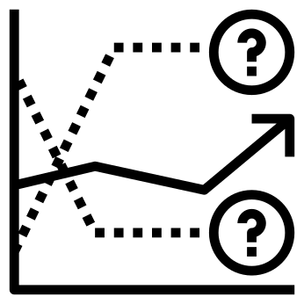




Energy
Load Forecasting
Ateet Maharjan

Slide 2
Energy
Load Forecasting
Ateet Maharjan

Slide 3







Roadmap
1
2
Background
Data
5
3
Code
Review
Methodology
4
Results & Forecasting

Slide 4

Background
As electricity cannot currently be stored in large amounts, supply and demand must always be matched or balanced by system operators.
Accurate demand forecasting for energy load is important
Short term electrical load forecasting is critical in ensuring reliability and operational efficiency for electrical systems.

Slide 5
Objective
The capstone project
Predict daily loads (in kW) for a US utility company in different geographical regions for upcoming days.
Notes:
Electricity demand is subject to a range of factors such as weather conditions, calendar effect, economic activity, and electricity prices. However, only historical energy loads are taken into account for this project.

Slide 6
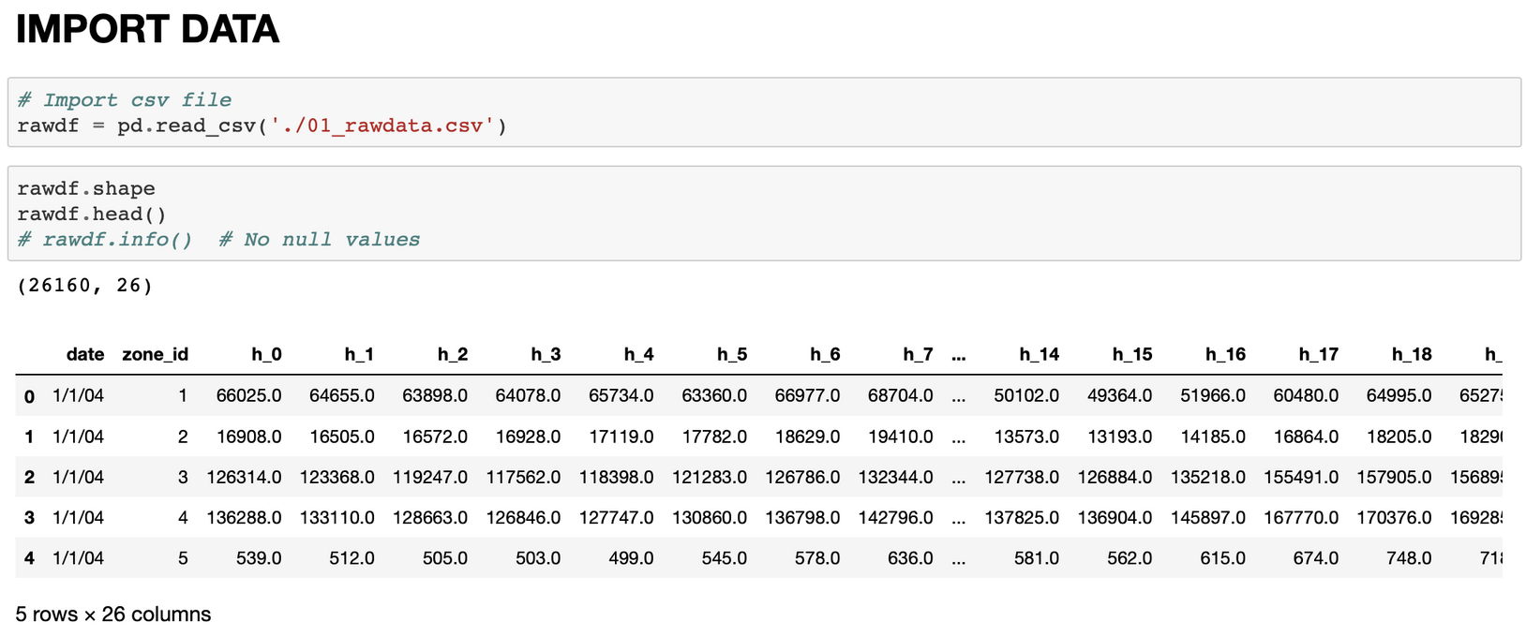
Data
The original dataset contains hourly load measurements for 15 geographic sub-areas (e.g., residential and industrial zones) from January 2004 to June 2008.
Notes:
Also, 8 weeks below in the load history were missing and required to be “backcasted”. The electrical loads for each of the eight missing weeks in the past were "backcasted" (in previous project) and the current project contains full dataset.

Slide 7
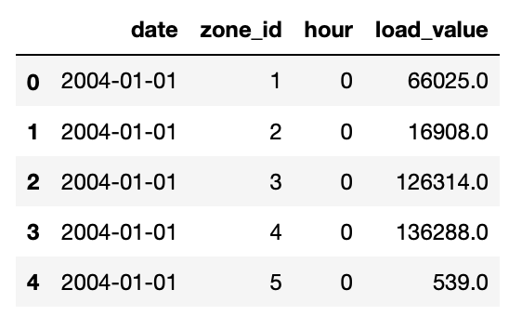
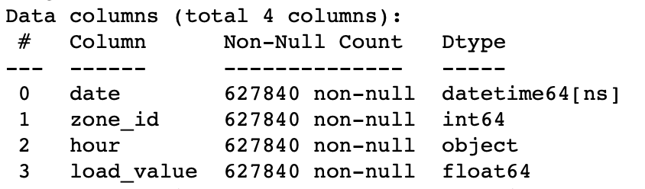
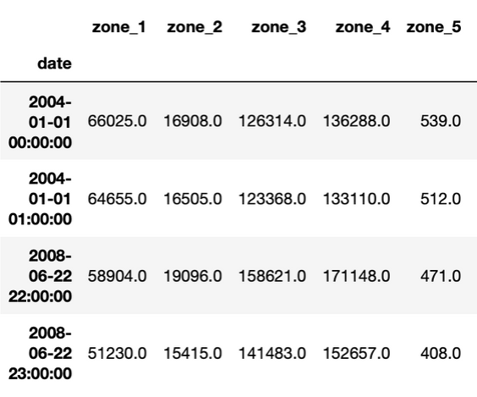
Processing
Data
Check for null values and outliers
Convert date column to datetime format
Stack hourly column and make datetime format
Unstack zone

Slide 8
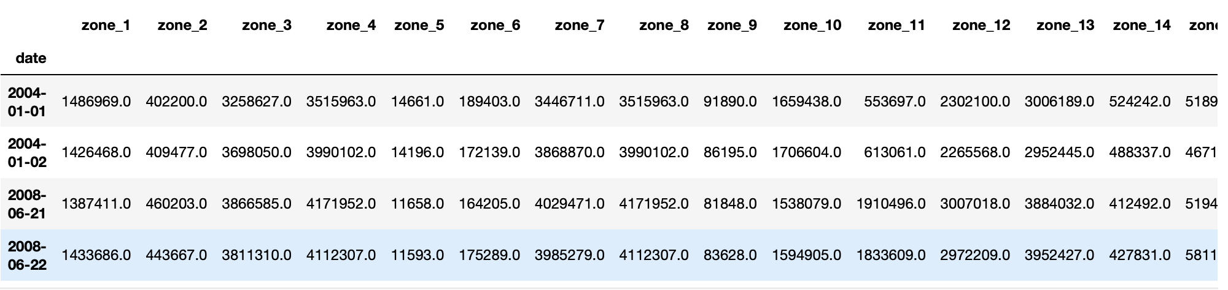
Resampling
Data
Hourly has multiple seasonality, for this project focus on daily data.
Take subset of dataframe (zone 1)

Slide 9
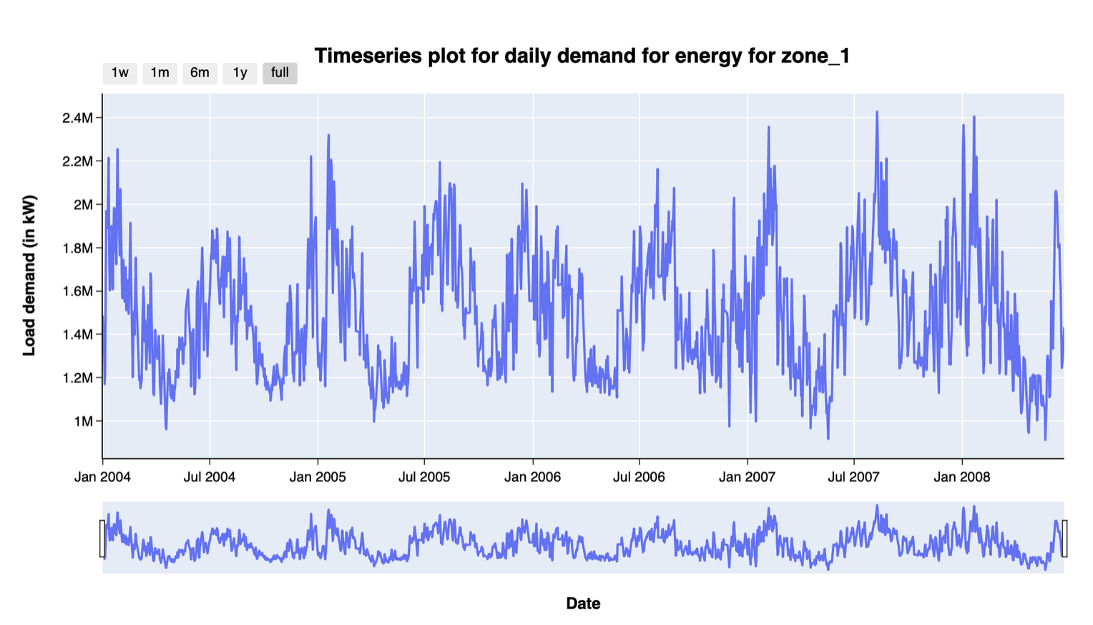
Presence of seasonality
Time series plot for daily energy load showing some annual
seasonality

Slide 10
Modeling:
Train/Test Split of Dataset
Full dataset (2004-01-01 to 2008-06-22)
Training dataset
(80 %)
Test dataset
(20%)
(2004-01-01 to 2007-07-31)
(2007-08-01 to 2008-06-22)

Slide 11
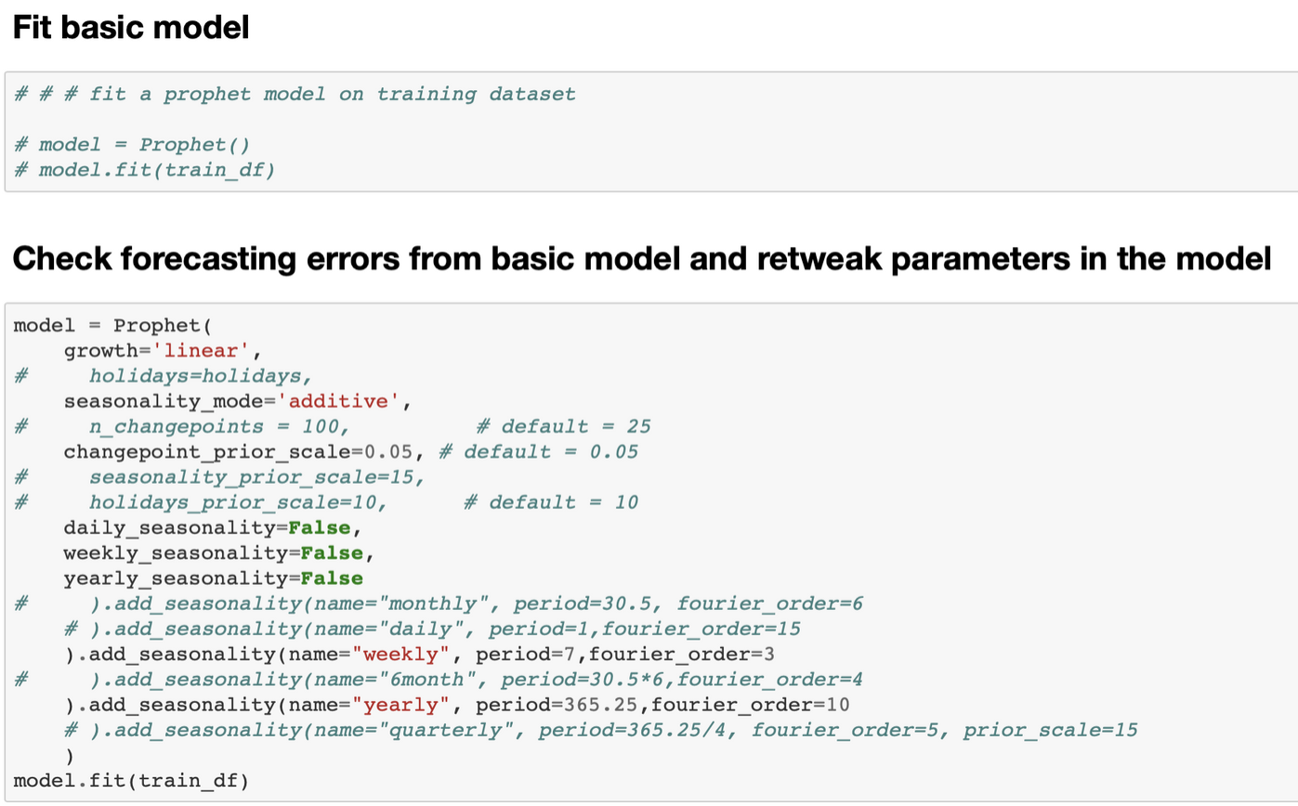
Modeling:
Fitting FbProphet
Fbprophet handles multiple seasonality and is a very good match for energy dataset.
Notes:
higher frequency time series often exhibit more complicated seasonal patterns. For example, daily data may have a weekly pattern as well as an annual pattern. Hourly data usually has three types of seasonality: a daily pattern, a weekly pattern, and an annual pattern.
multiple seasonal patterns are becoming more common with high frequency data recording. Further examples where multiple seasonal patterns can occur include call volume in call centres, daily hospital admissions, requests for cash at ATMs, electricity and water usage, and access to computer web sites.
Prophet handles multiple seasonality time series. This allows you to specify all of the frequencies that might be relevant.
Despite this flexibility, we don’t necessarily want to include all of these frequencies — just the ones that are likely to be present in the data.

Slide 12
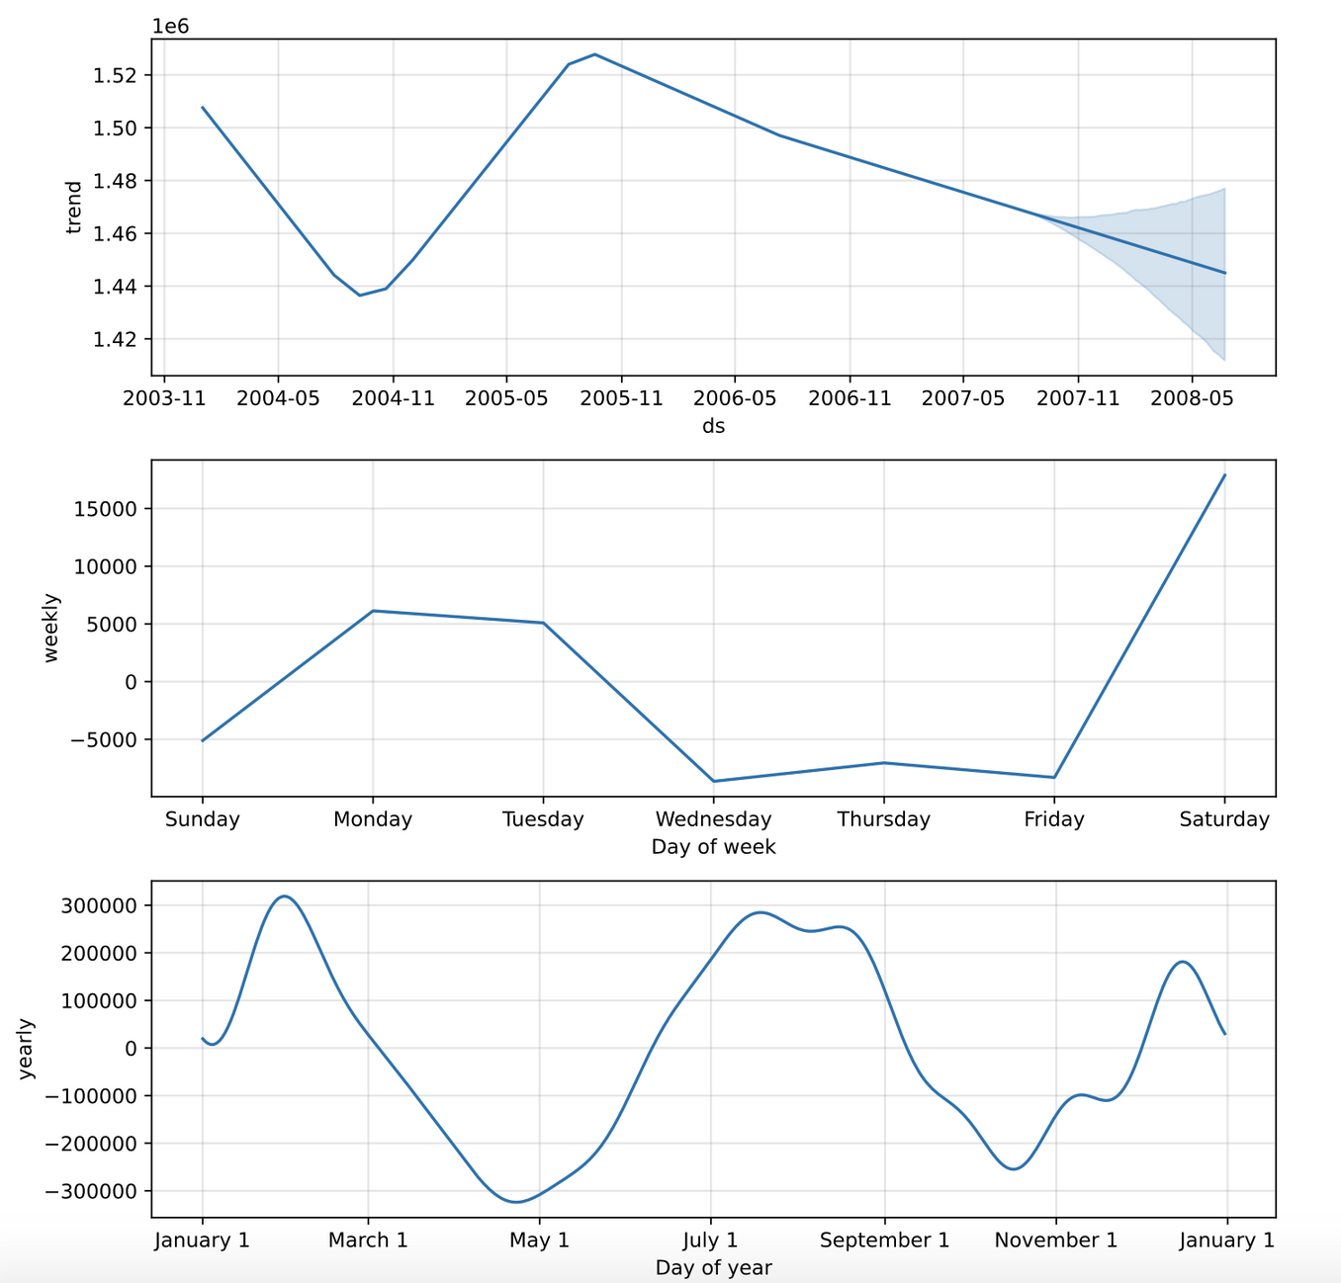
Component
plot
Presence of
trend and seasonality
Notes:
Increased trend was observed in 2005.
Weekly trend shows higher demand on monday, tuesday and saturday.
Yearly trend shows higher demand during January, February and July-August.

Slide 13
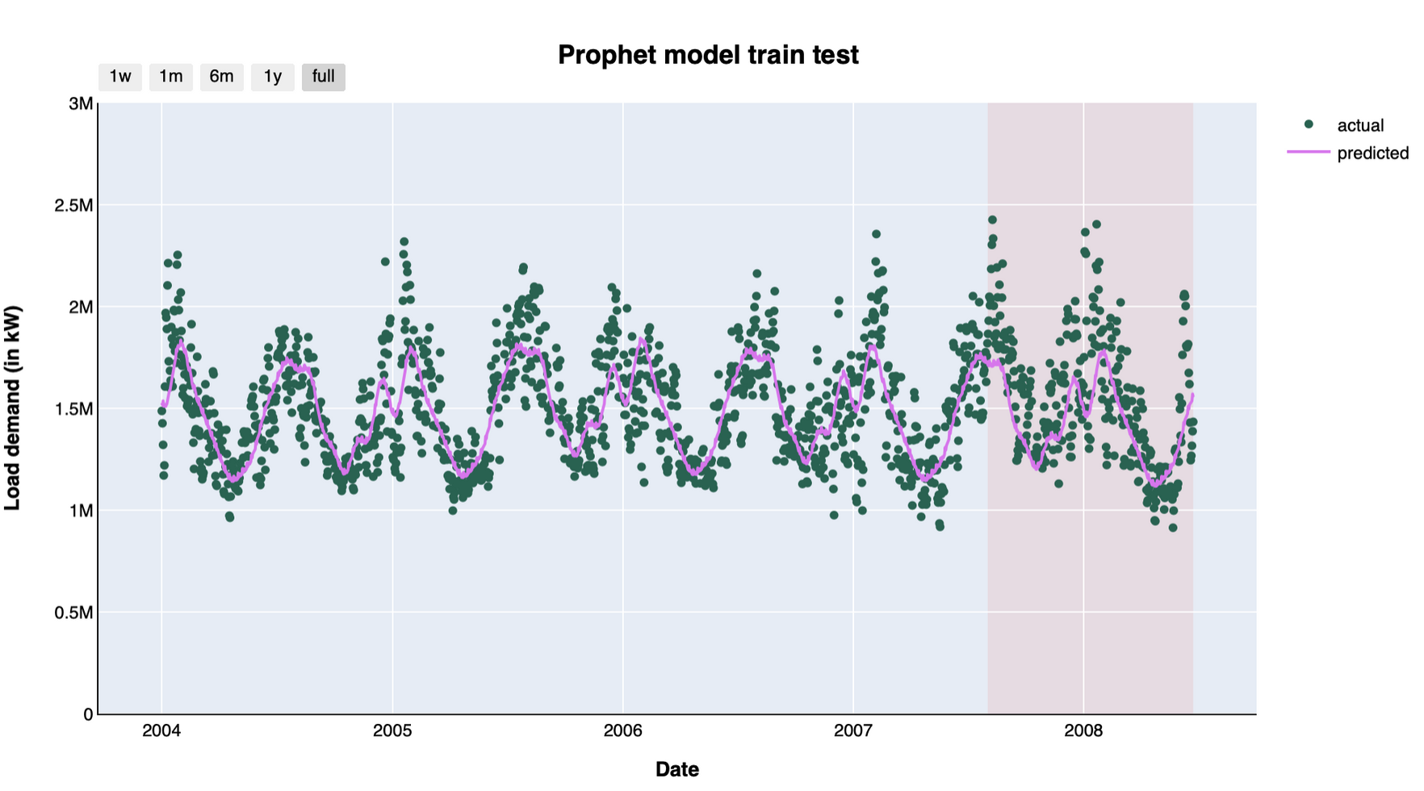
Evaluation of model
Basic model:
MAPE = 11.4
MAE = 187042.95
Tweaked model:
MAPE = 11.38
MAE = 186657.72

Slide 14
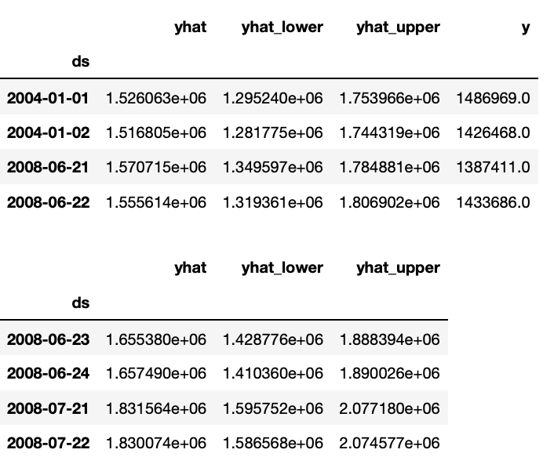
Model refitting
on full dataset
Prediction for 30 days ahead

Slide 15
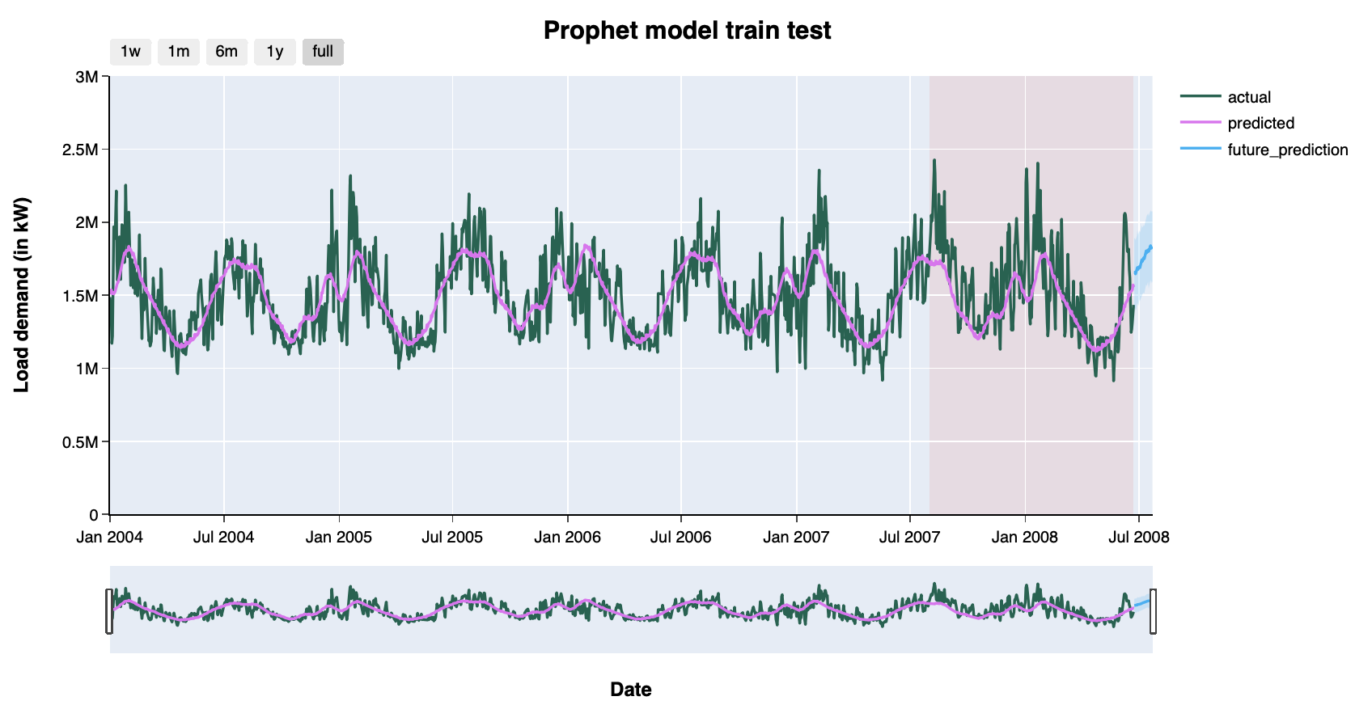
Forecast plot

Slide 16

What could have been done?
- Inclusion of factor such as temperature will improve the error.
- Retweak parameters in fbprophet model.
- Cross Validation
- Combining multiple forecasts and taking average.
- Dynamic Time series considering 2008's The Great Recession.
Notes:
- Only historical data for energy load has been used. Inclusion of other factor such as temperature will improve the error.
- Retweak parameters in fbprophet model.
- Cross Validation
- Combining multiple forecast: An easy way to improve forecast accuracy is to use several different methods on the same time series, and to average the resulting forecasts.
Dynamic Time series considering 2008's The Great Recession

Slide 17


App Deployment
https://energy-load.herokuapp.com

Slide 18


Code Review

Slide 19
Thank you.
Any Question?

